Slide 1

Logic Circuits
Hoszu Bernadett – IE group 913
12.01.2022

Slide 2
Logic circuits...
A logic circuit is a combination of logic gates
A logic gate takes the input from its input wires and combines them with the appropriate Boolean operation to produce the label on its output wire.
To model the functionality of logic circuits, we use Boolean functions. The variables of the function correspond to the input wires of the circuit and the gates implement one of the operations: and, or, not, xor, nand, nor, nxor. The final output of the whole circuit represents the function’s expression.

Slide 3
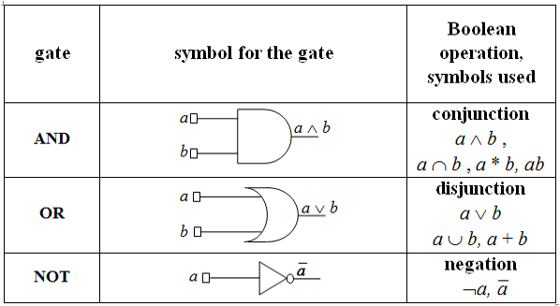
Basic gates

Slide 4
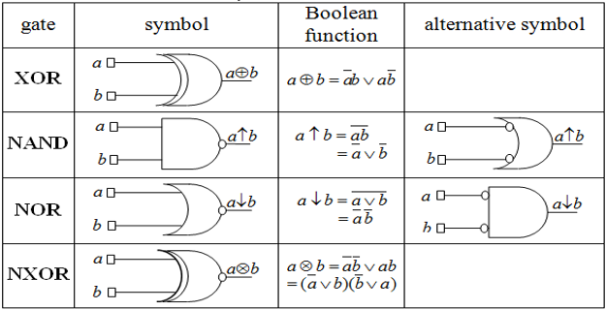
Derived gates

Slide 5
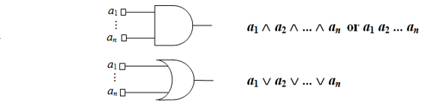
More on gates
The and and or gates can be generalized to have more input variables
nand, nor, nxor can also have any number of inputs, but generally, commercial gates are limited to 2, 3 or 4 inputs to fit the standard IC (integrated circuits) packages.

Slide 6
Exercise 2.8
Exercises_Logic_Circuits_2021-2022.docx

Slide 7
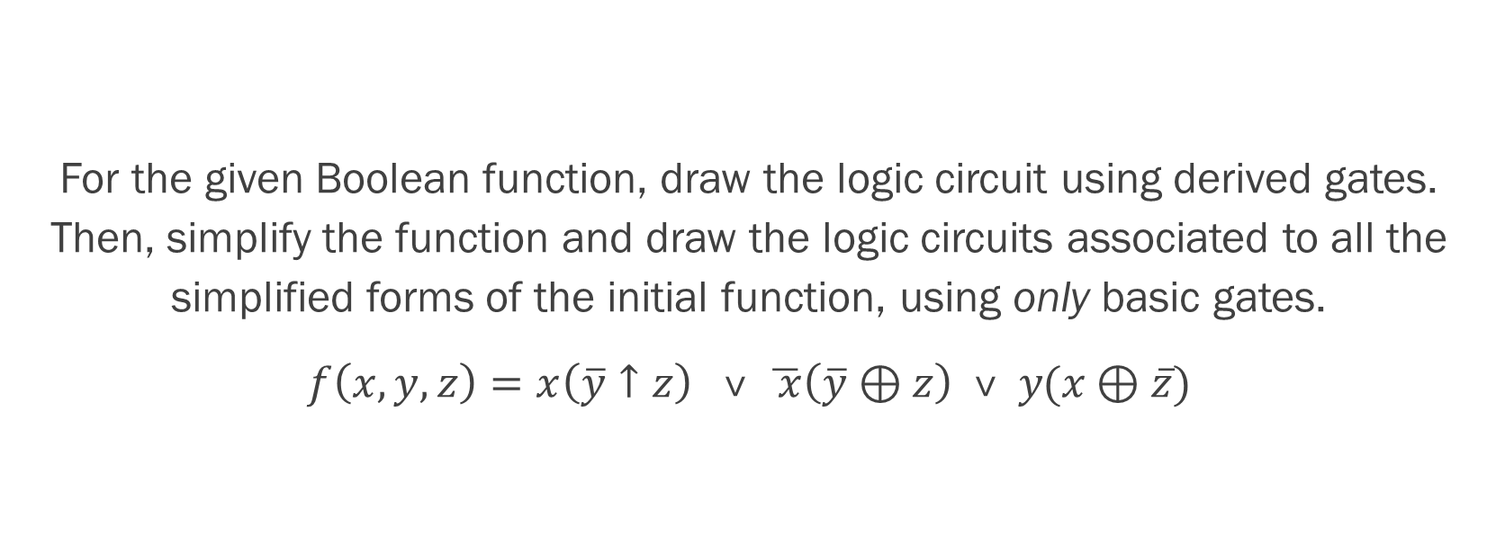
Problem statement
For the given Boolean function, draw the logic circuit using derived gates. Then, simplify the function and draw the logic circuits associated to all the simplified forms of the initial function, using only basic gates.
$f\left(x, y, z\right)=x\left(\overline{y}↑z\right) \text{˅} \overline{ x}\left(\overline{y} \text{⊕} z\right) \text{˅} y(x \text{⊕} \overline{z})$

Slide 8
How do we start?
We begin by tackling the parantheses, then the conjunctions with the literals from the front, and the last thing is uniting them into a disjunction (using the or gates, which, as we know, can have several input wires – i.e 3).

Slide 9













x
x
$$x \text{⊕} \overline{z}$$
z
$$\overline{z}$$
$$\text{⊕}$$
$$y(x \text{⊕} \overline{z})$$
not
y
˅
y
y
not
x
$$\overline{ x}$$
not
f
˅
$$\overline{ x}\left(\overline{y} \text{⊕} z\right)$$
$$\overline{y}$$
$$\overline{y}$$
˅
$$\overline{y} \text{⊕} z$$
z
$$\text{⊕}$$
z
z
$$\overline{y}↑z$$
$$↑$$
$$\overline{y}$$
˅
$$x\left(\overline{y}↑z\right)$$
x

Slide 10
Simplifying f
For this we use the Veitch diagram and apply the simplification algorithm.
First step is bringing f to DCF.
$f\left(x, y, z\right)=x\left(\overline{y}↑z\right) \text{˅} \overline{ x}\left(\overline{y} \text{⊕} z\right) \text{˅} y(x \text{⊕} \overline{z})$ = $x\left(y˅\overline{z}\right) \text{˅} \overline{ x}\left(\text{yz} \text{⊕}\overline{y}\overline{z}\right) \text{˅} y\left(\overline{x}\overline{z}\text{⊕}xz\right)=$
$=x\text{y} \text{˅} x\overline{ z} \text{˅} \overline{ x}yz \text{˅} \overline{ x}\overline{y}\overline{z} \text{˅} \overline{x}y\overline{z} \text{˅} xyz$
$=x\text{y}\overline{z} \text{˅} x\overline{y}\overline{z} \text{˅} \overline{ x}yz \text{˅} \overline{ x}\overline{y}\overline{z} \text{˅} \overline{x}y\overline{z} \text{˅} xyz$
$=m_{6} \text{˅}{ m}_{4} \text{˅}$ $m_{3} \text{˅}$ $m_{0} \text{˅}$ $m_{2} \text{˅}$ $m_{7}$

Slide 11







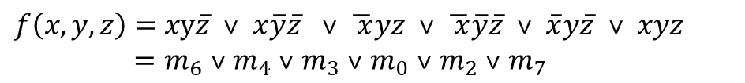




Simplifying f
x
$$\overline{x}$$
$f\left(x, y, z\right)=$ $x\text{y}\overline{z} \text{˅} x\overline{y}\overline{z} \text{˅} \overline{ x}yz \text{˅} \overline{ x}\overline{y}\overline{z} \text{˅} \overline{x}y\overline{z} \text{˅} xyz$
$=m_{6} \text{˅}{ m}_{4} \text{˅}$ $m_{3} \text{˅}$ $m_{0} \text{˅}$ $m_{2} \text{˅}$ $m_{7}$
y
$$m_{7}$$
$$m_{6}$$
$$m_{2}$$
$$m_{3}$$
We can cover all the minterms by applying only double factorizations.
$$\overline{y}$$
$$m_{4}$$
$$m_{0}$$
$max1 =m_{6} \text{˅}{ m}_{4} \text{˅}$ $m_{2} \text{˅}$ $m_{0}$
$max1 ={m_{7} \text{˅} m}_{6} \text{˅}$ $m_{2} \text{˅}$ $m_{3}$
z
$$\overline{z}$$
z
The set of maximal monoms is:
$$M\left(f\right)= \left\{max1, max2\right\}$$
As seen in the diagram, all the factorizations are central factorizations as they contain minterms which are only covered once. So:
$$C\left(f\right)= \left\{max1, max2\right\}$$

Slide 12

Simplifying f
So, we are in the first case of the simplification alforithm, when $M\left(f\right)=$ $C\left(f\right)$, and we have a unique simplified form of f:
$$f^{S} \left(x, y, x\right)=max1 \text{˅} max2=\overline{z} \text{˅} \text{y}$$

Slide 13



The logic circuit using only basic gates
x
y
y
$$f^{S} \left(x, y, x\right)=\overline{z} \text{˅} \text{y}$$
$$\text{˅}$$
z
$$\overline{z}$$
z
not

